Slide 1
Mobile Development
David Stern
Notes:
The outcomes are:
Describe at least two key elements of developing mobile software
List tools for developing mobile software
Describe how mobile applications interface with other applications including the cloud
Describe the differences between designing for mobile applications and embedded applications

Slide 2
Objectives
Developing mobile software – application development process
Different types of mobile applications and tools for development
Interfacing with the cloud
Mobile vs Embedded applications
Notes:
The outcomes are:
Describe at least two key elements of developing mobile software
- Application development process (planning/architecture, GUI design (wireframes, prototyping, mockups), development, testing, deployment and maintenance)
List tools for developing mobile software
- Xcode (iOS), Android Studio (Android), React Native and Flutter (CPMA)
Describe how mobile applications interface with other applications including the cloud
- APIs – What hosting in the cloud looks like, how APIs are called, benefits of using APIs
Describe the differences between designing for mobile applications and embedded applications

Slide 3
Mobile vs Desktop
Mobile
Touch controlled
Size constraints
Battery
Processor
Screen
Limited on languages that can be used
Cell phones and infotainment systems
Desktop
Uses peripherals
No hardware restrictions
Large choice of languages
Towers

Slide 4
Android OS vs iOS
Android
Free to everyone
More development freedom
Android Studio
Run on all OS, including Mac
C, C++, XML, Java, and Kotlin
Needs to support everything
iOS
Closed ecosystem
Strict development rules
XCode
Only on Mac
Objective C, Swift, SwiftUI
Fewer, exclusive devices

Slide 5



Android Operating System
Created in 2008
Mobile operating system
Phones
Tablets
Watches
(New) Automotive
Free and open-source software
Used in cars – Google’s Open Automotive Alliance
Audi, GM, Honda, Hyundai, Bentley, Chevrolet, Chrysler, Ford, Mazda, and many more
https://www.openautoalliance.net/#press

Slide 6
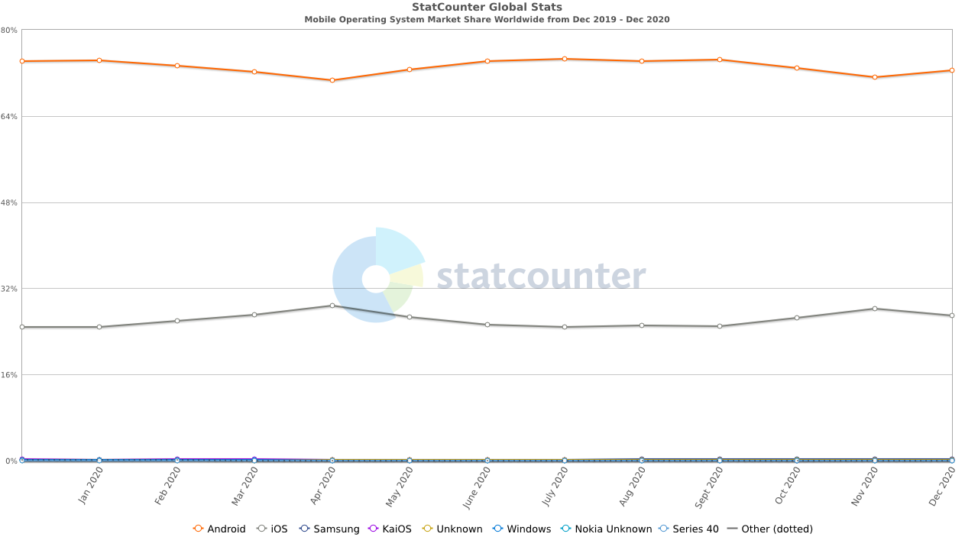
Android OS vs iOS Market Share

Slide 7

Types of Mobile Applications

Slide 8
Web VS Native
Web Apps
Run on the web and are stored on remote servers
Accessed with an active network connection through a browser
Low cost, easy maintenance, cross platform compatibility
Native Apps
Mobile app developed to work on a specific platform or operating system
Using Android Studio and Java/Kotlin for Android, or XCode and Swift for iOS
Best performance and functionality
Most expensive
Notes:
Web Apps
Pros
One can dramatically lower costs with the help of Web based applications due to reduced support and maintenance, lower requirements on the end user system and simplified architecture.
Web application development systems need only be installed on the server placing minimal requirements on the end user workstation. Maintaining and updating the system is much simpler, ny client updates can be deployed via the web server with ease.
Most web based applications are far more compatible across platforms than traditional installed software. Typically, the minimum requirement would be a web browser of which there are many.
Cons
Requires a network connection
Harder to find, not on an app store
Native Apps
Pros
Very fast and efficient because the specific hardware/operating system were known when designing
Cons
Very costly
Long development time

Slide 9
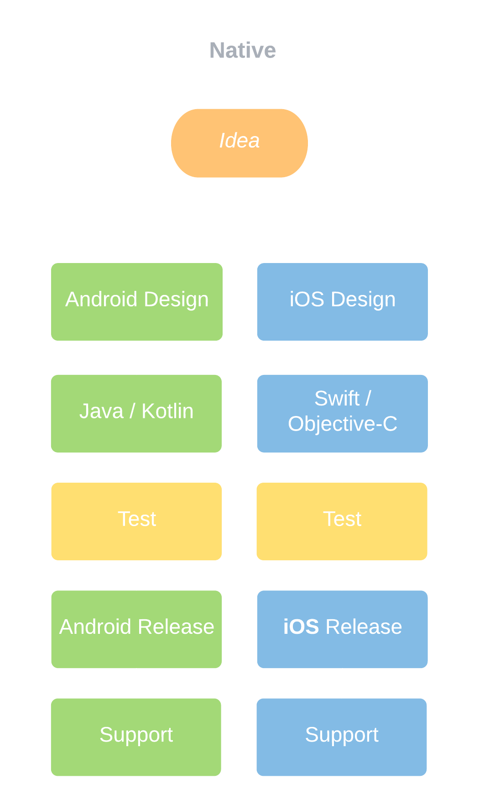
Native App Development

Slide 10
Android - Development Tools
Java Development Kit (JDK)
Android Studio – Official Android IDE
Android Software Development Kit (SDK)

Slide 11
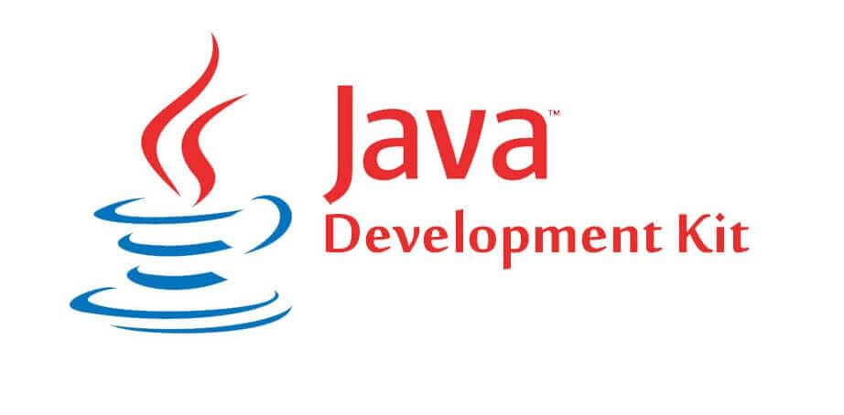
Used to build Java programs
Contains a Java compiler
Needs to be installed to use Android Studio

Slide 12
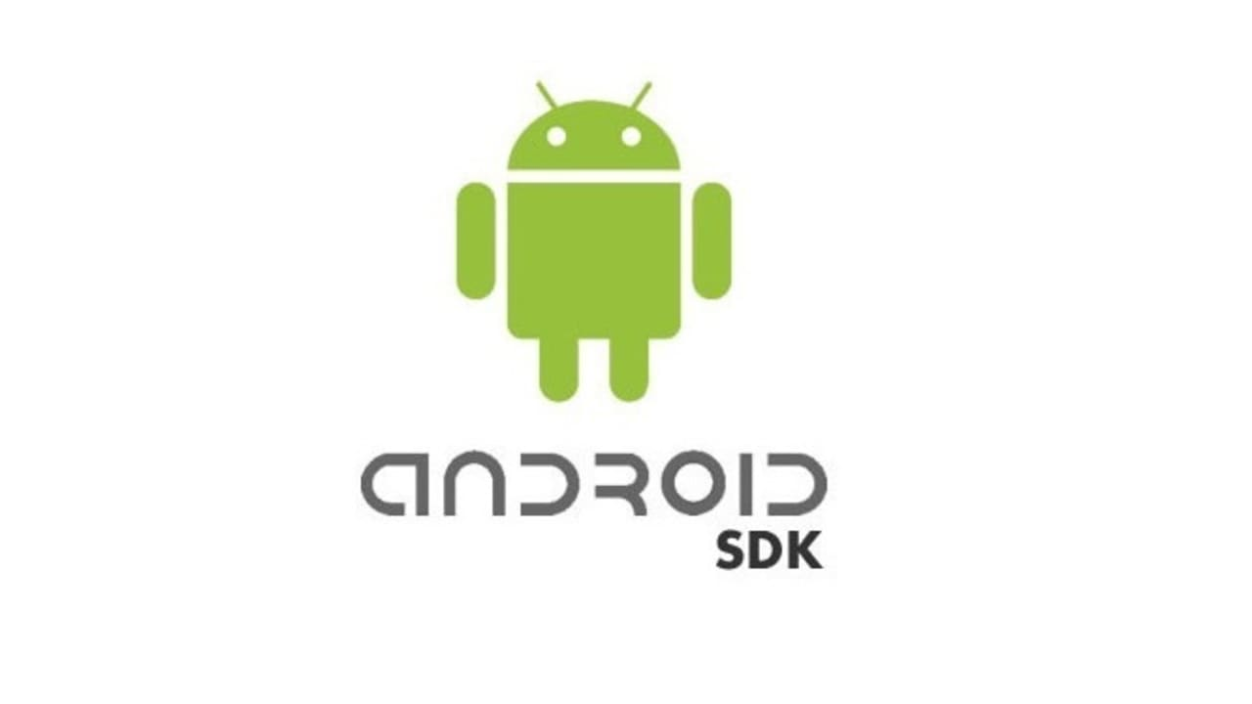
Android Software Development Kit
Installed by Android Studio
The “toolbox” of everything needed to create Android applications

Slide 13
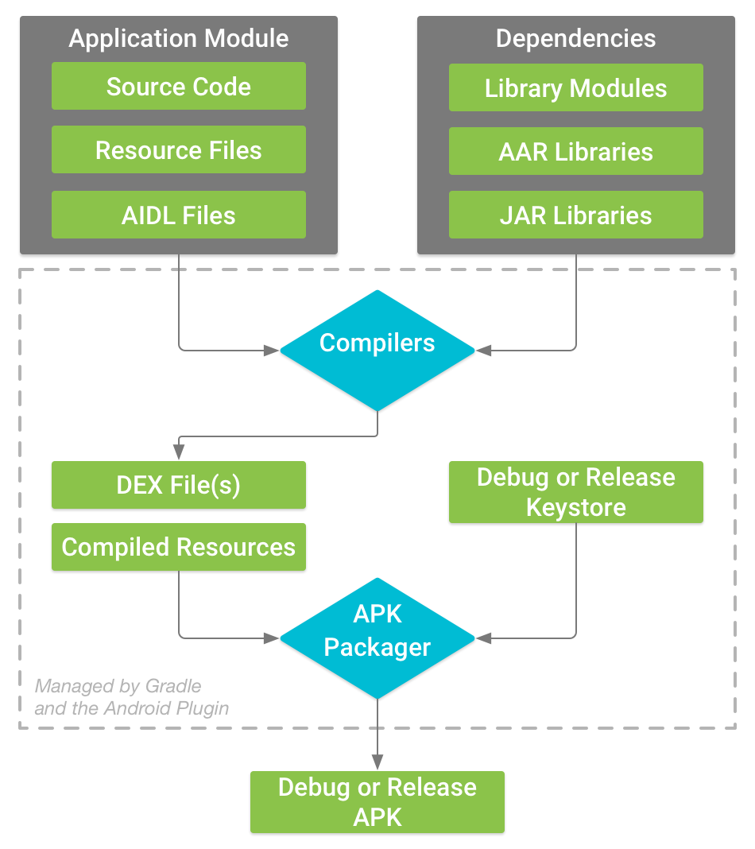
Build Process

Slide 14
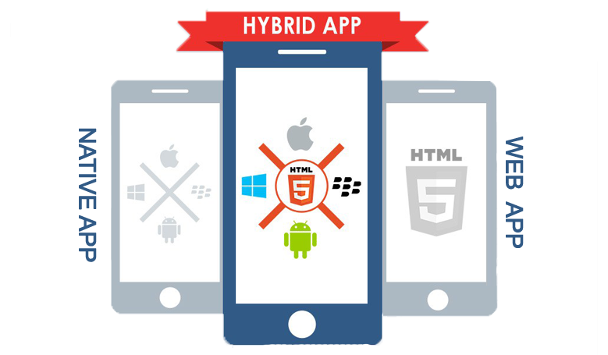
Mobile Application Development
Hybrid Apps
A blend of web apps and native apps
Code written in web development languages (HMTL, CSS, JavaScript) is embedded into a native app
Lower performance, but good pilot solution
https://siliconithub.com/native-vs-hybrid-app/
Notes:
Hybrid Apps
Pros
They can work across various platforms, i.e., they can operate on both, Android & iOS since they have a single code base. Also, the consistent user interface (UI) enables it to function on most of the devices.
The development and maintenance (which includes updates and making changes) of hybrid applications is faster since developers must create only one codebase.
The single code base in the hybrid apps makes them cost-effective since it requires lesser time to develop and does not require more developers as in the case of Native apps.
Cons
Since Hybrid apps have a foundation similar to that of Web apps, they need an uninterrupted network connection to work to their full potential.
Owing to their architecture, hybrid mobile apps rely on plugins to access the inbuilt features of the mobile device.
Hybrid applications don’t offer a user experience as great as native apps do since the interface for both, the Android and the iOS are compromised on. In case too much focus is given on Android, the user experience for iOS users will be compromised on, and vice versa.
The contradiction in the case of developing a Hybrid app is, Native app developers are required to create a Hybrid application because the development of a Hybrid app does not fix a range of functional issues that are fundamental for Native app development.

Slide 15
Cross Platform Mobile Application Development
Hybrid App
Run on the web and are stored on remote servers
Accessed with an active network connection through a browser
Low cost, easy maintenance, cross platform compatibility
Native Apps
Mobile app developed to work on a specific platform or operating system
Using Android Studio and Java/Kotlin for Android, or XCode and Swift for iOS
Best performance and functionality
Most expensive
Notes:
Web Apps
Pros
One can dramatically lower costs with the help of Web based applications due to reduced support and maintenance, lower requirements on the end user system and simplified architecture.
Web application development systems need only be installed on the server placing minimal requirements on the end user workstation. Maintaining and updating the system is much simpler, ny client updates can be deployed via the web server with ease.
Most web based applications are far more compatible across platforms than traditional installed software. Typically, the minimum requirement would be a web browser of which there are many.
Cons
Requires a network connection
Harder to find, not on an app store
Native Apps
Pros
Very fast and efficient because the specific hardware/operating system were known when designing
Cons
Very costly
Long development time

Slide 16
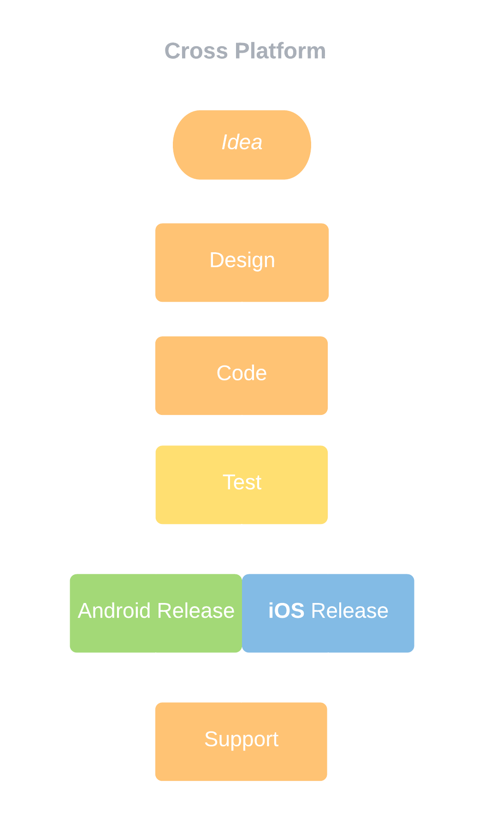
Cross Platform App Development

Slide 17
Native vs Cross-Platform

Slide 18
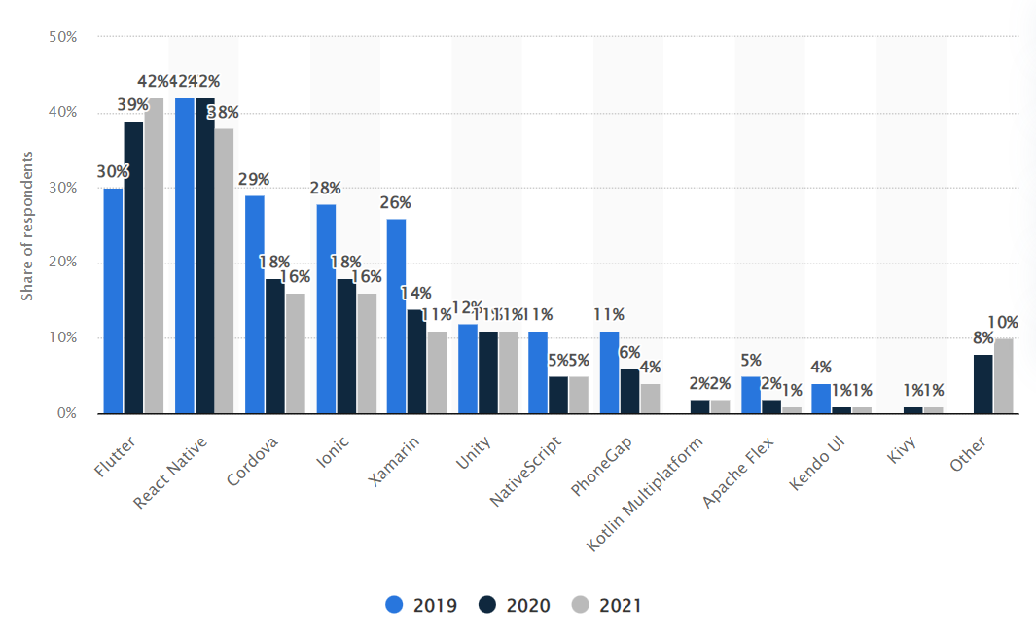
https://www.statista.com/statistics/869224/worldwide-software-developer-working-hours/

Slide 19
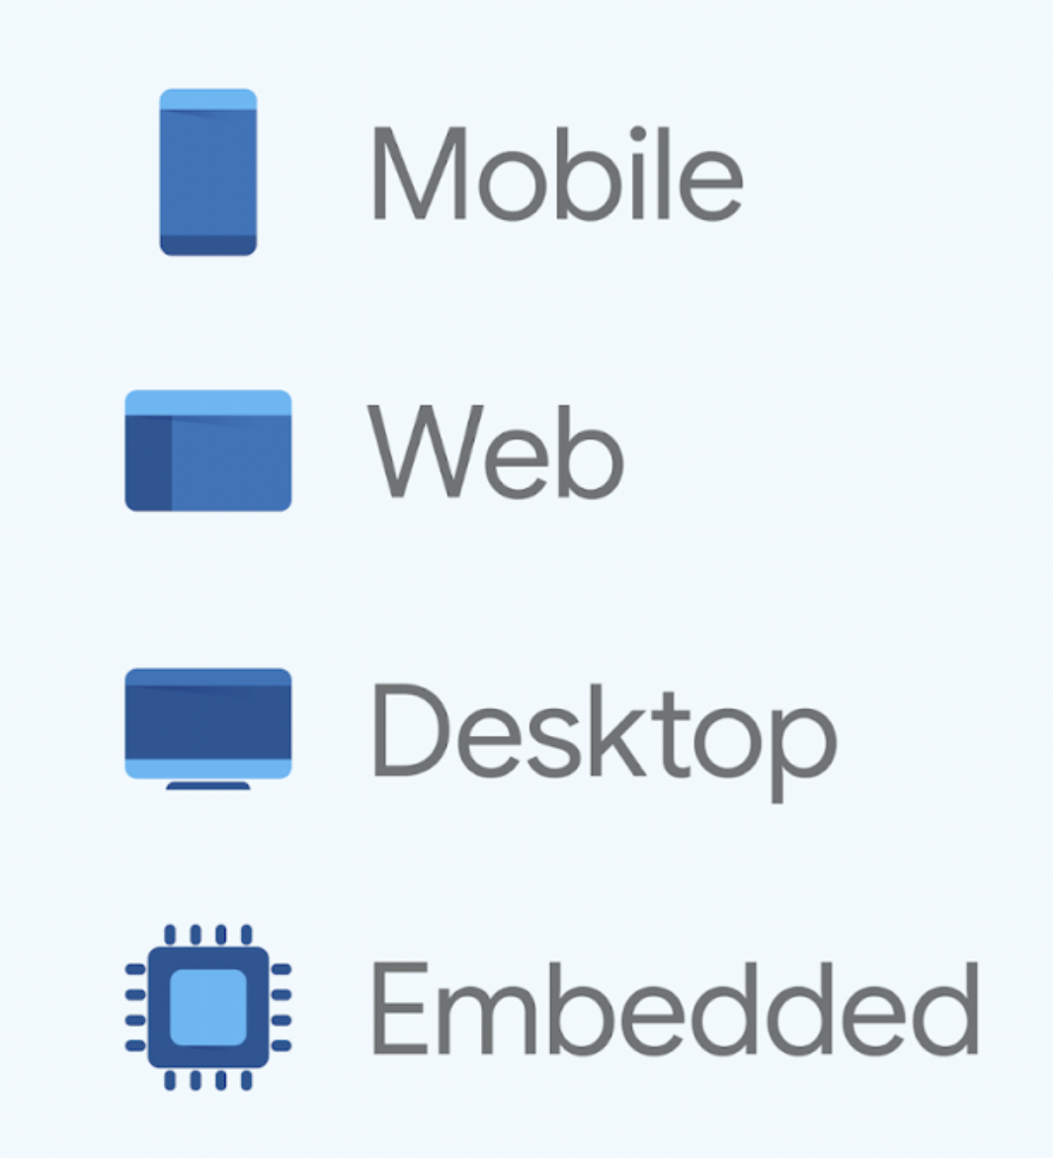
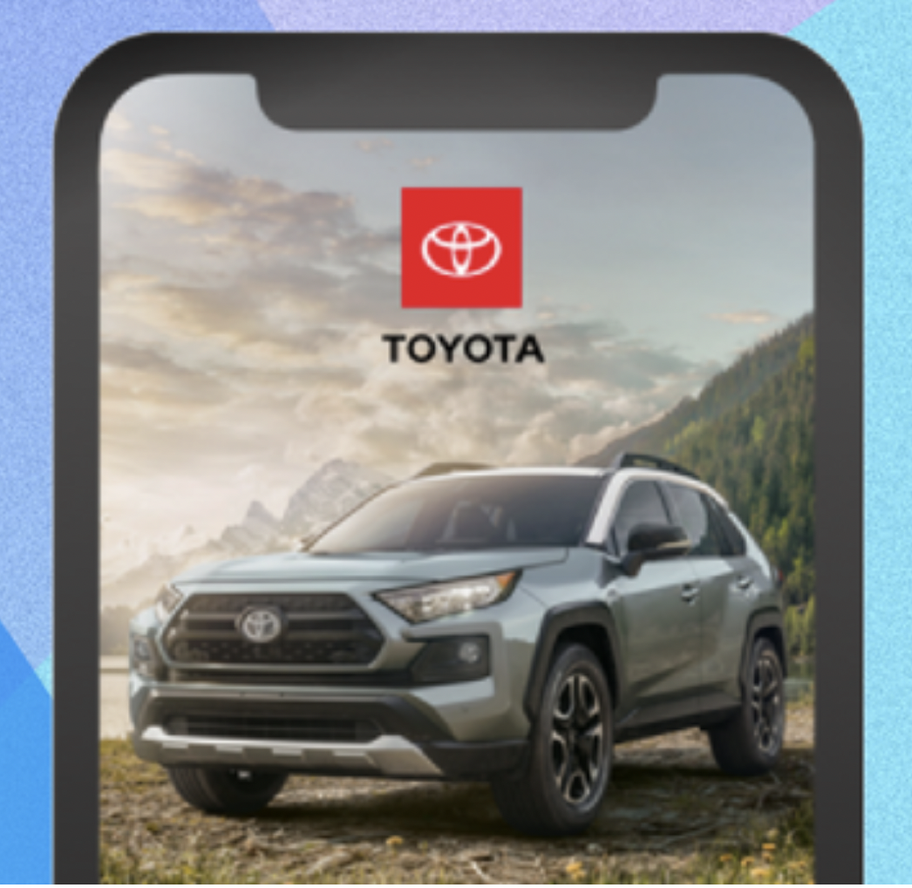
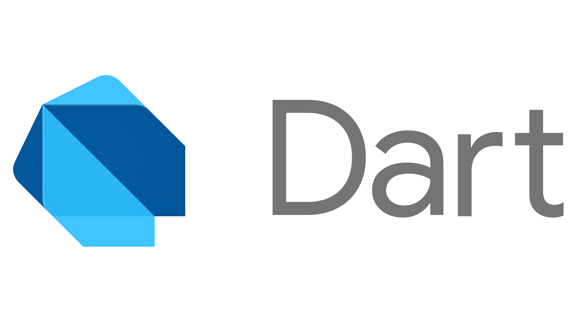
Flutter
Toyota Infotainment
(Embedded Example)
Multiplatform

Slide 20
Flutter
Google announced Flutter 1.0 is available for cross-platform development on December 4, 2018
Completely free
An API for creating applications
https://docs.flutter.dev/
Offers a fast development cycle with Stateful Hot Reload
Especially useful for the Graphical User Interface (GUI)
Notes:
Flutter is an API for creating apps. Most Flutter apps run on mobile devices but can run on laptop and desktop computers as well.
It is an open-source framework by Google for building these applications from a single codebase
Hot reload:
When a hot-reload is invoked, the host machine checks the edited code and since last compilation and recompiles only the affected libraries:
Any library with changed code
The application’s main library
The libraries from the main library leading to affected libraries
Then, the Dart VM reloads all of the affected libraries with the updated code
The hot-reload updates classes with new versions of fields and functions, the Flutter framework then automatically rebuils, repaints, and re-layouts the widget tree allowing the effects of the changes to be viewed quickly

Slide 21
Flutter vs React Native
Free
Uses the Flutter API for GUI
Has two design libraries available
Material Design
Cupertino
$300 - $1900 for professional projects
Uses the Android and iOS APIs for GUI
No option to use only one API
Notes:
Flutter is completely free no matter what it is used for
React Native is free for personal use, but for professional development it can cost between $300-$1900 for a license
The way Flutter and React Native display components is very different.
When a React Native application is run on an iPhone, the app calls on the iOS API to create iOS buttons, text fields, and other visual components. The same is true for Android development. Components created by the Android and iOS APIs do not look alike. The two APIs use different shapes, color palettes, navigation schemes, and more. These differences can, and are, enough of a reason for developers to not want to use it because the goal of some cross-platform applications is to make the app look the same on all platforms.
Flutter does not call these APIs to display the app’s components. Flutter specifies all of the pixels required to draw a button, text field, image, or anything else and just has the iOS and Android APIs draw those pixels.
Flutter has the option to make the iOS app have that “iOS look”. Flutter has a built-in library available, the Cupertino library, that makes components look like iOS components.

Slide 22


Mobile Development

Slide 23
Application Development Process
Architect/Plan
User Interface
App Development
Testing
Deployment and Support

Slide 24
Analysis / Plan
Create
Create a list of functional requirements
Prepare
Prepare a product roadmap
Identify
Identify skills needed
What will it need to do?
Who will it do it for?
When will it do it?
Create an MVP
Milestones timeline
Development stack
Consider the deployment target(s)
Notes:
This is the stage where app transforms from an idea into a project
First, you need to define use cases and get detailed functional requirements
What is everything it will need to do?
When will it need to work?
Who does it need to work for?
Product roadmap
Prioritize the mobile app requirements and group them into delivery milestones
Define the minimum-viable-product (MVP) and prioritize this for initial launch
Google, start with just finding links from word searches. Eventually, things like image searches
Identify skills needed
What technology stack is used?
Android or iOS or web/other
Will it need to use databases?

Slide 25
Navigation to Nearest Charging Station
Create
Find and give directions to nearest charging stations
Prepare
1 – Upon user instruction, navigate to closest station
Identify
Android development
Electric vehicle drivers
When we are low on battery or when the user wants to
Offline capabilities
2 – Allow user to select from map of stations
3 – Automatically begin directions when battery is low
API to retrieve addresses of stations and optimize directions
Database to store user data
Notes:
This is the stage where app transforms from an idea into a project
First, you need to define use cases and get detailed functional requirements
What is everything it will need to do?
When will it need to work?
Who does it need to work for?
Product roadmap
Prioritize the mobile app requirements and group them into delivery milestones
Define the minimum-viable-product (MVP) and prioritize this for initial launch
Google, start with just finding links from word searches. Eventually, things like image searches
Identify skills needed
What technology stack is used?
Android or iOS or web/other
Will it need to use databases?

Slide 26
User Interface
Wireframes – digital form of sketches
Reference the destination’s style guide
Mockups
Notes:
You want to deliver a seamless and effortless user experience
Ideally, people will think to themselves “This looks professional/ or nice”
List what the user interface will need
What data will be displayed to the users
What data will be collected
User interactions with the finished product, and the user journeys within the app
Wireframes
Designers will normally start by making sketches on paper of what the layout will be
Wireframes are a digital form of these sketches
They contain conceptual layouts to give a visual structure to the app’s functional requirements
The focus is more on aesthetics and user experience, not color schemes and styles
Should consider device specific design
Research the style guide for the destination device
What font family will your app’s text use?
What will the color scheme be?
How should navigation be handled?
https://developer.android.com/design
Mockups
Mockups are the final renderings of your app’s visual design
Created by applying your style guide to the wireframes
Should be close to, or exactly what the app will be built to look like
Prototype
Not always done
Build the interface using design software with actual functionality
Figma and Invision

Slide 27
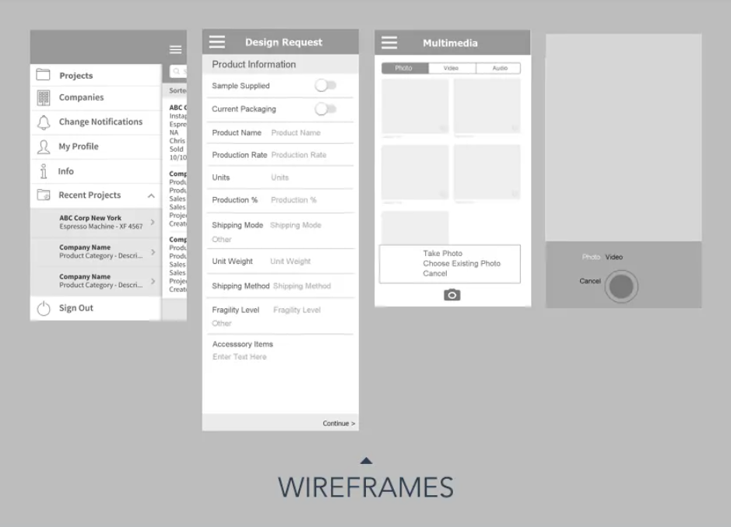
[1]
https://www.figma.com/file/OUK8DHtzk6xGRWBcKEypnR/Wireframing-in-Figma?node-id=0%3A1
Notes:
Wireframes
https://www.figma.com/file/OUK8DHtzk6xGRWBcKEypnR/Wireframing-in-Figma?node-id=0%3A1

Slide 28
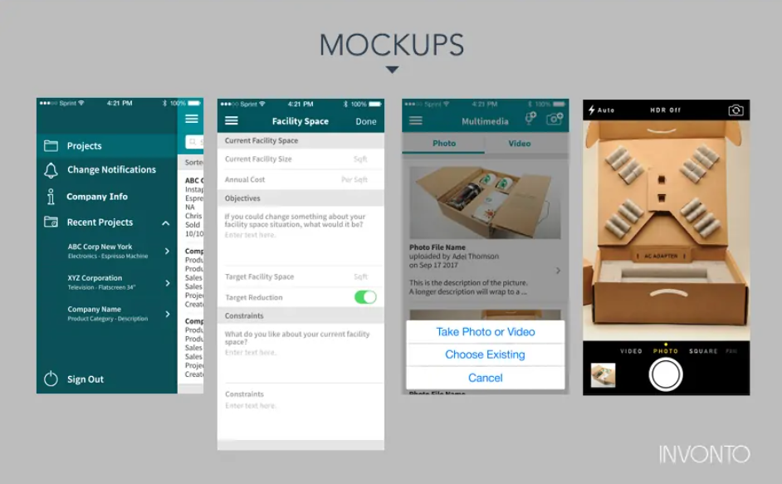
[1]
https://www.figma.com/file/TWtbV2xJYPiw704QwnJb7Q/Prototyping-in-Figma?node-id=0%3A1
Notes:
Mockups
https://www.figma.com/file/TWtbV2xJYPiw704QwnJb7Q/Prototyping-in-Figma?node-id=0%3A1

Slide 29
Android Styling
https://developer.android.com/design
Android Auto – Interacting with your vehicle using an Android phone application
Automotive OS – Infotainment platform applications are directly loaded onto (no phone necessary)
Styles and layouts
Components – things available to build the user interface with
Car branding – car makers can set accent colors and icons of applications in their systems to reflect their own branding

Slide 30
Prototypes - Figma
Clear expectations for end users and developers
Excellent for demos and marketing
Possibly cheaper
Notes:
Check out Figma, go to Design from the main menu and scroll through
https://www.figma.com/

Slide 31
App Development
Back-end / server technology
API
Mobile app front - end
Notes:
There is a phase of planning before this stage is implemented
Define the technical architecture
Pick a technology stack
Define the develop milestones
For mobile applications there are three integral parts
Back-end / server technology
API(s)
Mobile app front-end
Back-end / server technology
Includes databases and server – side objects necessary for supporting functions of the app
If you are using an existing back-end platform, then modifications may be needed to support the mobile functionality
API
An Application Programming Interface is a method of communication between the app and a back-end server or database
Mobile app front-end
The mobile app an end-user will use
Consists of interactive user experiences that use an API and a back-end for managing data. Sometimes local storage if offline functionality is supported
Limitless options on choice of non-local databases and server programs
Not as many options for native mobile apps
iOS – Swift or Objective-C
Android – Java or Kotlin
As functionality of these elements are completed, they move into testing

Slide 32
Testing
User experience testing
Functional testing
Performance testing
Security testing
Device and platform testing
Notes:
Why do testing?
Assures the app is stable, usable, and secure

Slide 33

User Experience Testing
Check the visuals, workflow, and interactivity of the app
Verify there is consistent styling
Notes:
User experience testing
Make sure the visuals workflow, and interactivity of the app are what they should be – follows the user interface design that was made
Verify that the styling (fonts, colors, layouts) are consistent
Reference: https://xd.adobe.com/ideas/process/user-testing/conduct-usability-user-testing-for-mobile-apps-like-a-pro/

Slide 34
Functional Testing
Ensure there are no issues with any of the app’s features and functionality
Test as many cases as possible with as many people as possible
Can be broken down into system testing, and further into unit testing
// Example simple function
fun helloWorld(name: String = “World”): String {
return “Hello, ${name}!”
}
// Example unit test
@Test fun helloWorldReturnsPersonalizedMessage() {
assertEquals(“Hello, Molly!”, helloWorld(“Molly”))
}
@Test fun helloWorldReturnsGenericMessage() {
assertEquals(“Hello, World!”, helloWorld())
}
Notes:
Functional Testing
The purpose is to ensure that users can use your app’s features and functionality without any issues
Try to predict every end-user’s behavior and usage scenario
Have the app tested by as many users as possible in as many different test cases as possible
This testing can be broken down into system testing which is the app working as a whole
Example of car temperature app
Log in – Log out
Log in – Change desired temperature -> log out
etc
It can be broken down even further into unit testing which is making sure individual functions of the app are operating correctly
A unit test makes sure each function will always work

Slide 35
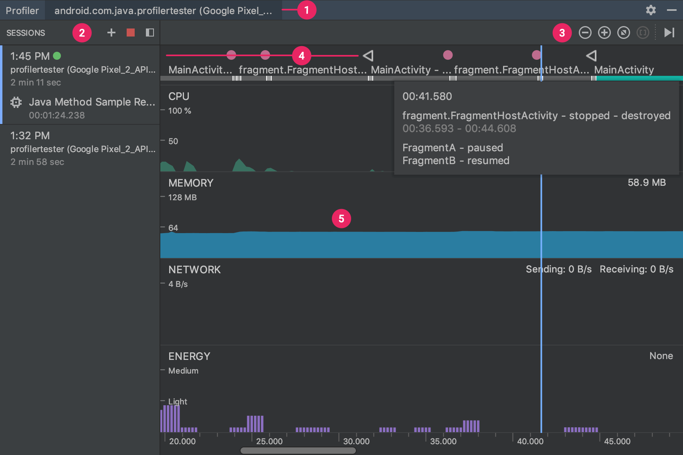
Performance Testing
Quantitative criteria to measure the performance of the app
How fast? Memory leaks? Battery draining? Too big?
Test to maximum load
[3]
Notes:
Performance testing
Quantitative criteria to measure the performance of the app
How well is the app responding to user requests?
Are there reports of the app crashing?
How fast are the screens loading?
Are there memory leaks? Is the battery draining?
Does the app leverage network bandwidth efficiently?
Is the size of the app appropriate for its functions?
Usually the databases, back-end, and API are tested for max load by simulating the maximum number of concurrent users
The app should be able to perform well even when the usage spikes

Slide 36
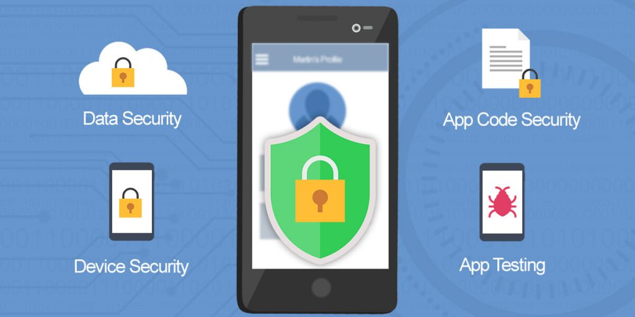
Security Testing
Any potential vulnerability can lead to a hack
Common to hire outside agencies to perform security testing
[4]
Notes:
Security testing
Any potential vulnerability can lead to a hack
For enterprise apps, it is commonplace to hire outside agencies to perform security testing
During a mobile application security test, the testing team will enumerate the application as much as possible to determine how the application works and what functionality the application supports. The team will then assemble a testing plan based on each component’s potential risk, prioritizing the highest risk areas first. Then specific mobile app test cases for each of the “key areas” will be performed to identify vulnerabilities and develop exploits.
If your app requires users to log in, these log in sessions should be tracked on the device and the backend.
User sessions should be terminated by the system when a user has remained idle for an extended time (typically ten mins or less on a mobile app).
If your app stores user credentials on the device to make it convenient for them to re-login, then you must ensure using a trusted service.

Slide 37

UNECE Regulation 155
United Nations Economic for Europe World Forum for Harmonization of Vehicle Regulations
Baseline of threats, vulnerabilities and attack methods
Mitigations to the threats which are intended for vehicle types
Mitigations to the threats which are intended for areas outside of the vehicle types
Possible attack impacts
OWASP
Notes:
WP .29 is the United Nations Economic Commission For Europe (UNECE) World Forum for Harmonization of Vehicle Regulations. They passed Regulation 155 in January of 2021 which deals with cybersecurity and cybersecurity management systems (CSMS) in vehicles. Although it is aimed at the manufacturers, it has impacts across the entire supply chain.
The Open Web Application Security Project® (OWASP) is a nonprofit foundation that works to improve the security of software. Through community-led open-source software projects, the OWASP Foundation is the source for developers and technologists to secure the web.
Tools and Resources
Community and Networking
Education & Training

Slide 38

Security Testing
Public crowdsourcing of bug discovery - Bugcrowd
https://media.stellantisnorthamerica.com/newsrelease.do?id=17719&mid=
Pay the community $150 - $1,500 depending on the severity/impact of discovered bugs
Notes:
https://media.stellantisnorthamerica.com/newsrelease.do?id=17719&mid=
FCA US first full-line automaker to offer a “bug bounty” financial reward for the discovery of potential vehicle cybersecurity vulnerabilities (July of 2016)
Bug crowd is a community of cybersecurity experts that work on discovering bugs in different products and systems
Offers a way to discreetly report the bugs that are discovered in exchange for a payout

Slide 39
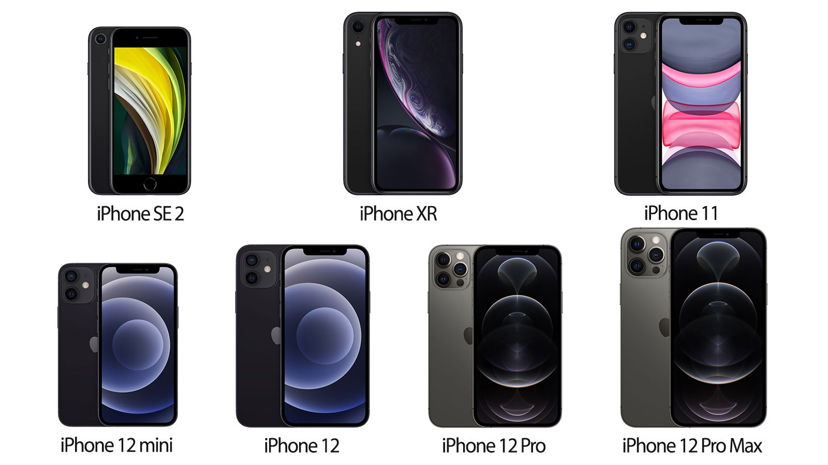
Device and Platform Testing
New devices landing on an annual basis
OS updates roughly every few months
Limited line of devices for iOS
Many devices for Android, all with different hardware and screen sizes
[5]
iOS phones in the last couple of years
Samsung
Oppo
Xiaomi
Vivo
OnePlus
Huawei
Realme
And more…
Some Android phone brands
Notes:
Device and platform testing
Typically, new devices are entering the market every 12 months and mobile operating systems are updated every months roughly
Apple has fewer devices to test on than Android

Slide 40
Emulator Deployment Considerations
Pros
Open and free to download
Provide analytics for test performance
Fast to cycle through devices when testing
Cons
Can’t check color/contrast of display in different weather conditions
Can’t emulate touchscreen issues
Consumes a lot of storage

Slide 41
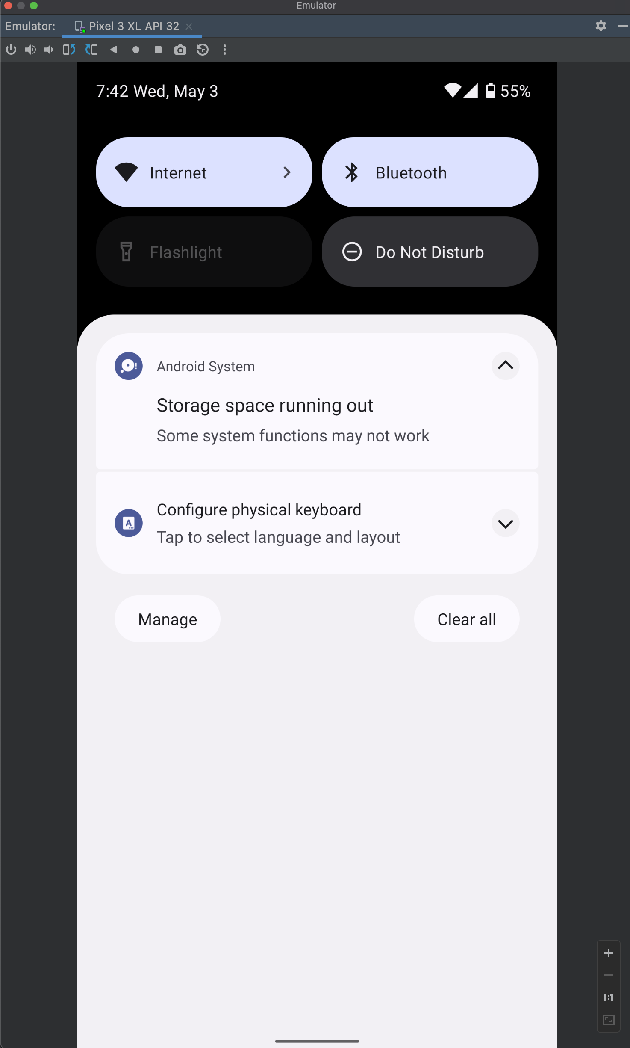
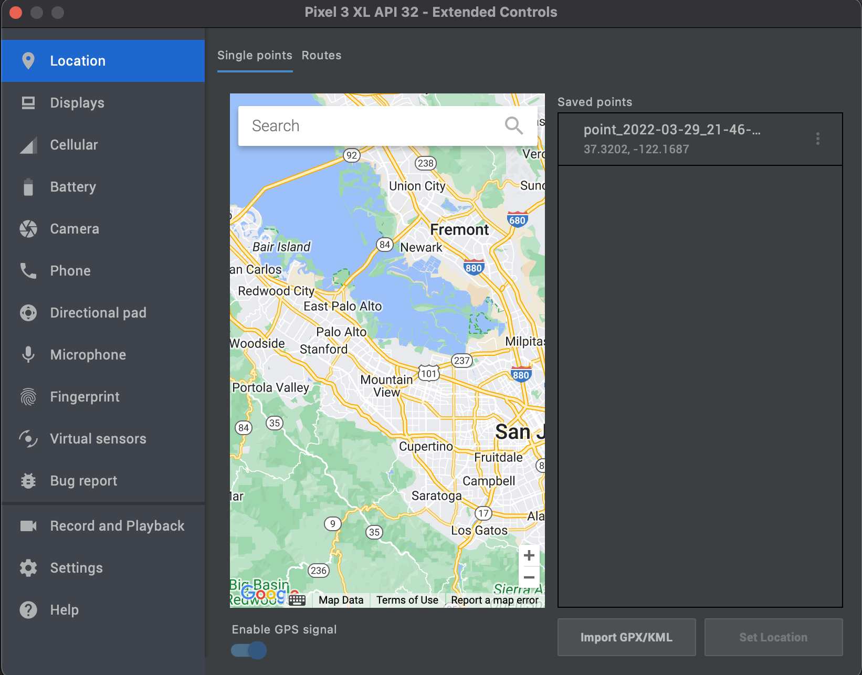

Slide 42
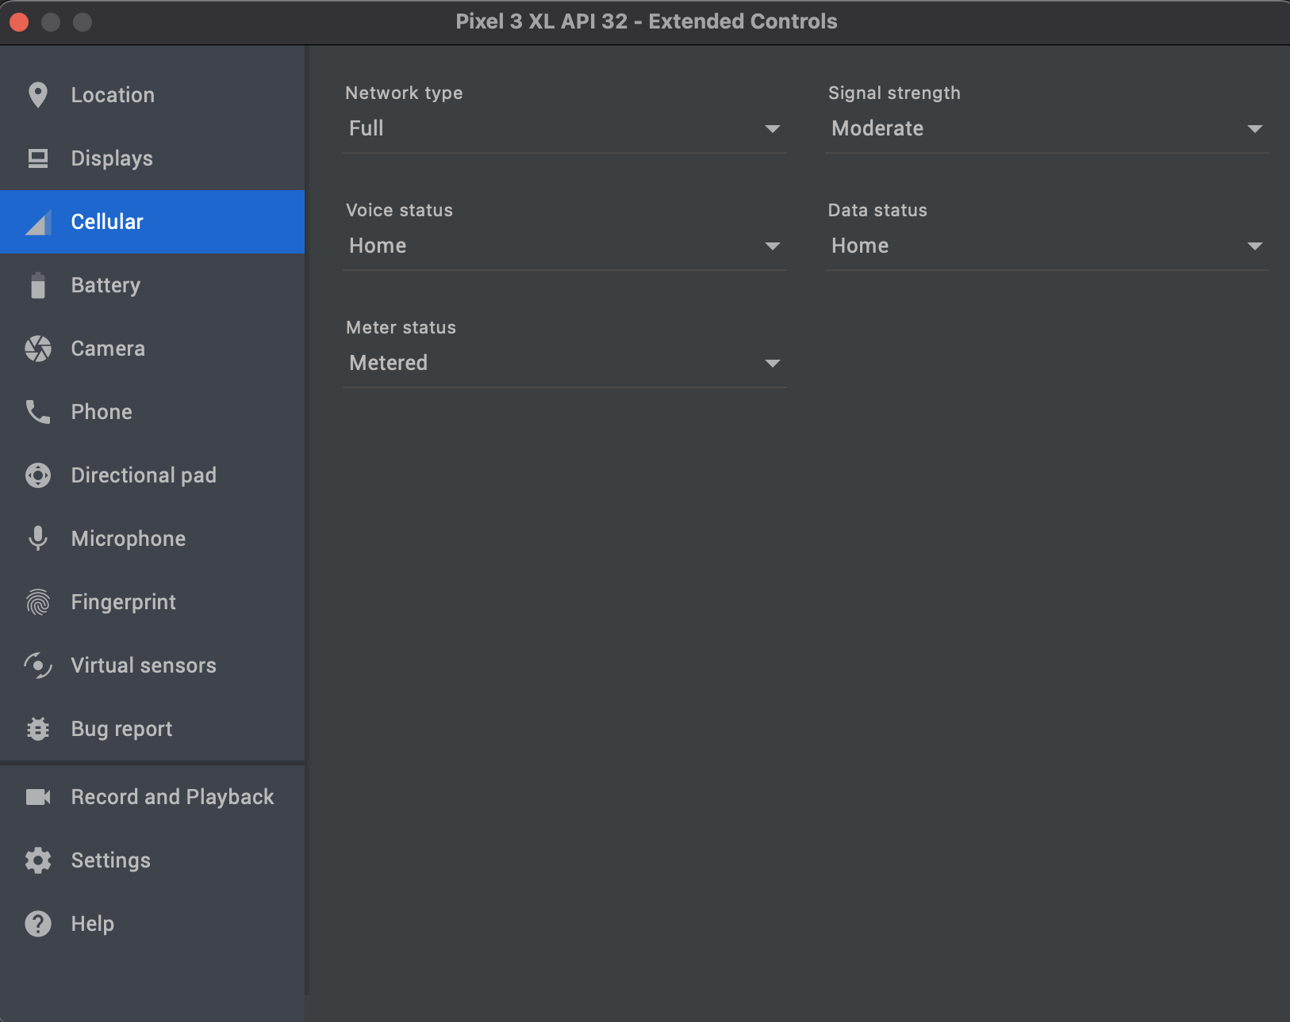

Slide 43
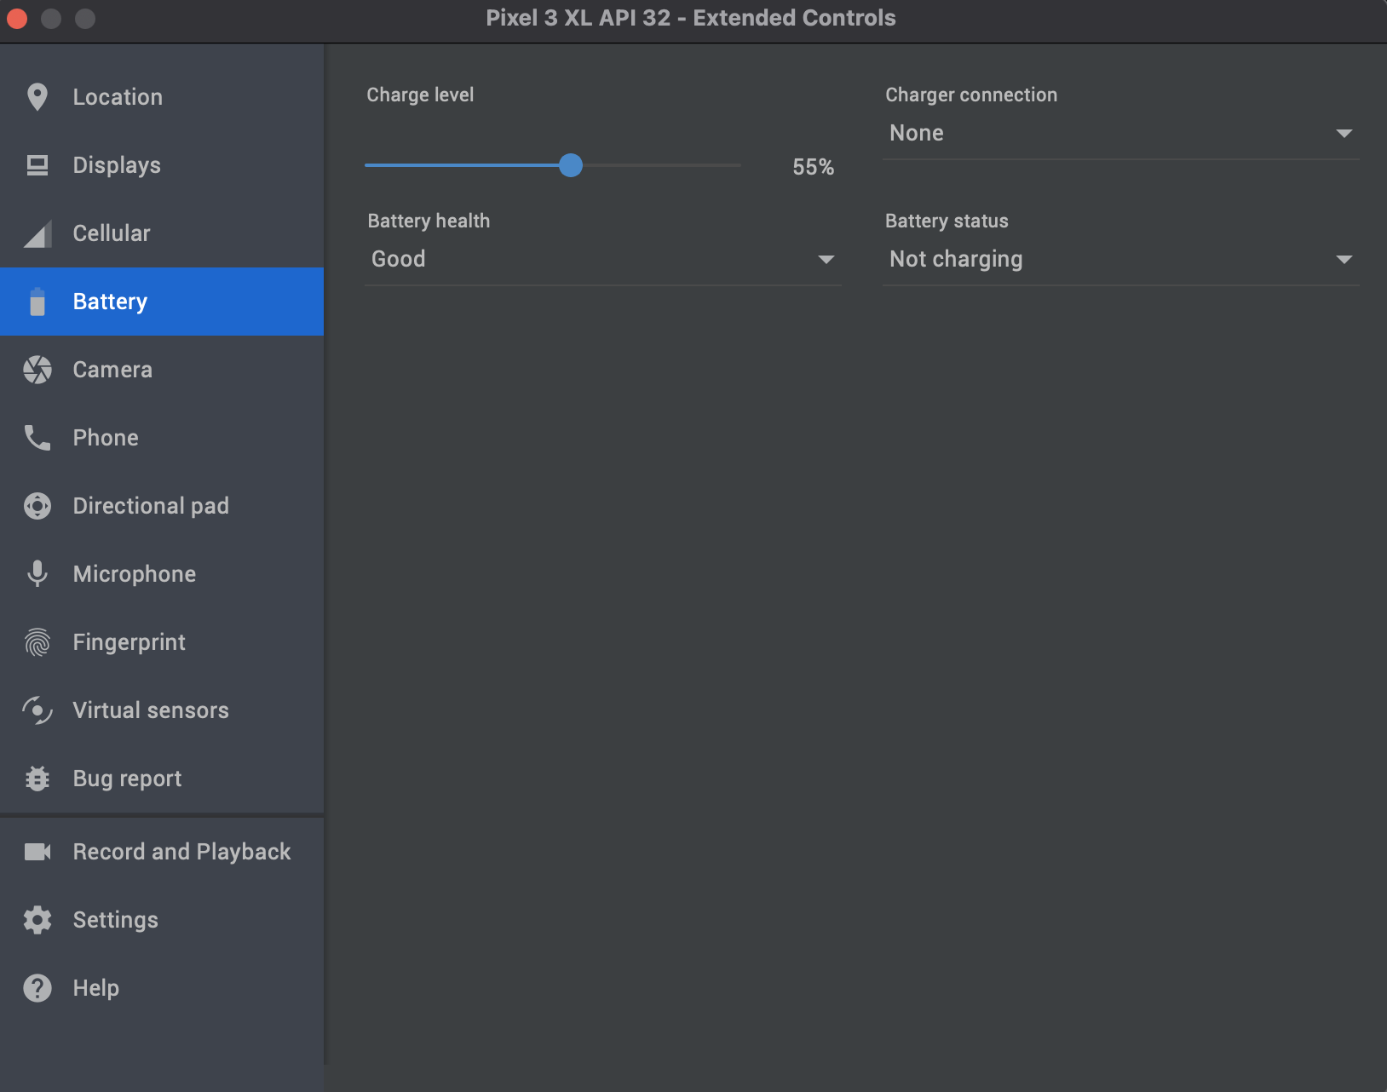

Slide 44
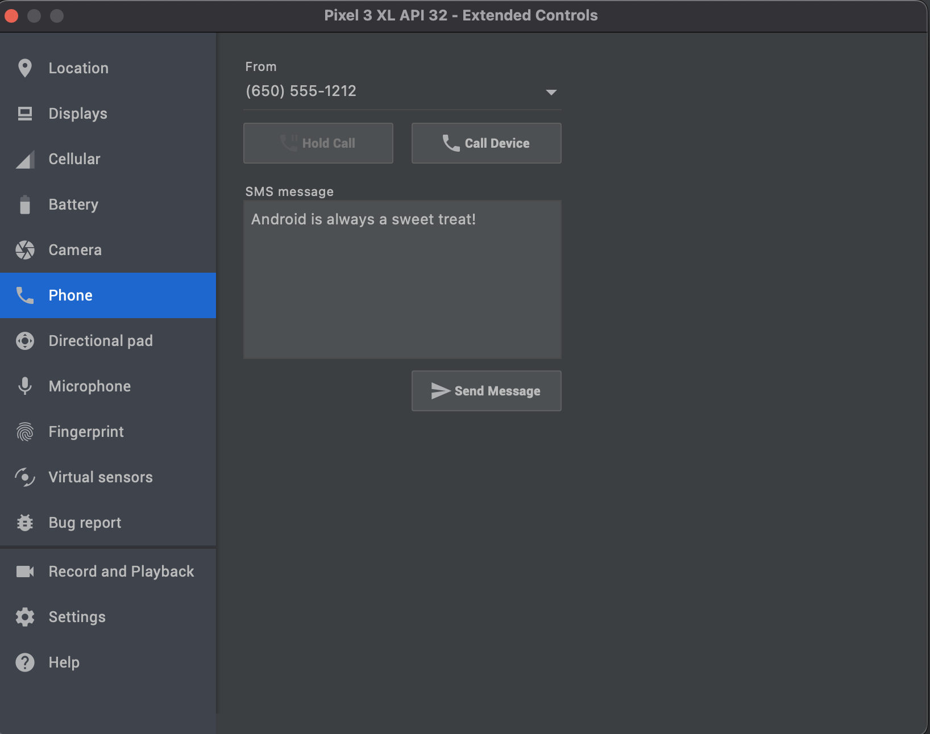

Slide 45
Deployment and Support
Release the app
Stay on top of technology advancements
Bug fixes
Notes:
Deployment
Publish the application
Get screenshots of the app’s screens
Write out description
Etc
Support
Regularly check crash reports and other statistics for the app
Technology advancements
Implement new features
Libraries can become deprecated
Bug fixes – resolve issues brought up by users

Slide 46
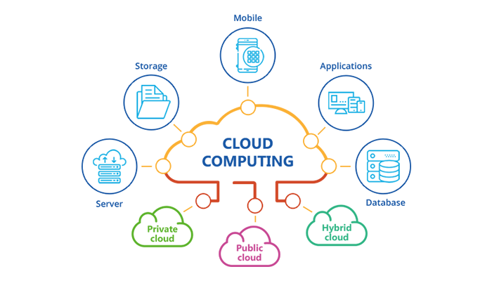
What is Cloud Computing?
Image: https://knowledgeballs.com/cloud-computing/
Notes:
Public clouds are owned and operated by third-party cloud service providers, which deliver their computing resources, like servers and storage, over the Internet. Microsoft Azure is an example of a public cloud. With a public cloud, all hardware, software, and other supporting infrastructure is owned and managed by the cloud provider. You access these services and manage your account using a web browser. Other third-party cloud service providers include Amazon’s web services, which we will be taking a closer look at, and Google’s cloud.
A private cloud refers to cloud computing resources used exclusively by a single business or organization. A private cloud can be physically located on the company’s on-site datacenter. Some companies also pay third-party service providers to host their private cloud. A private cloud is one in which the services and infrastructure are maintained on a private network.
Hybrid clouds combine public and private clouds, bound together by technology that allows data and applications to be shared between them. By allowing data and applications to move between private and public clouds, a hybrid cloud gives your business greater flexibility, more deployment options, and helps optimize your existing infrastructure, security, and compliance
hybrid cloud architecture focuses on the mechanics of transforming portions of a company's on-premises data center into private cloud infrastructure, and then connecting that infrastructure to public cloud environments hosted off-premises by a public cloud provider
Create cloud-native applications
Quickly build, deploy, and scale applications—web, mobile, and APIs.
Test and build applications
Reduce application development cost and time by using cloud infrastructures that can easily be scaled up or down.
Store, back up, and recover data
Protect your data more cost-efficiently—and at massive scale—by transferring your data over the Internet to an offsite cloud storage system that’s accessible from any location and any device.
Analyze data
Use cloud services, such as machine learning and artificial intelligence, to uncover insights for more informed decisions.
Stream audio and video
Connect with your audience anywhere, anytime, on any device with high-definition video and audio with global distribution.
Embed intelligence
Use intelligent models to help engage customers and provide valuable insights from the data captured.
Deliver software on demand
Also known as software as a service (SaaS), on-demand software lets you offer the latest software versions and updates around to customers—anytime they need, anywhere they are.

Slide 47
Benefits
Speed
$$$
Performance
Scale
Security
Notes:
Speed
Most cloud computing services are provided self service and on demand, so even vast amounts of computing resources can be provisioned in minutes, typically with just a few mouse clicks, giving businesses a lot of flexibility and taking the pressure off capacity planning.
Productivity - On-site datacenters typically require a lot of “racking and stacking”—hardware setup, software patching, and other time-consuming IT management chores. Cloud computing removes the need for many of these tasks, so IT teams can spend time on achieving more important business goals.
Database example – don’t need to plan on future proofing
COVID app I built in a weekend
Cost
Cloud computing eliminates the capital expense of buying hardware and software and setting up and running on-site datacenters—the racks of servers, the round-the-clock electricity for power and cooling, and the IT experts for managing the infrastructure. It adds up fast.
Performance
The biggest cloud computing services run on a worldwide network of secure datacenters, which are regularly upgraded to the latest generation of fast and efficient computing hardware. This offers several benefits over a single corporate datacenter, including reduced network latency for applications and greater economies of scale.
Reliability - Cloud computing makes data backup, disaster recovery, and business continuity easier and less expensive because data can be mirrored at multiple redundant sites on the cloud provider’s network.
Scale
The benefits of cloud computing services include the ability to scale elastically. In cloud speak, that means delivering the right amount of IT resources—for example, more or less computing power, storage, bandwidth—right when they’re needed, and from the right geographic location.
Did not need to worry about scaling my COVID app if it had taken off and needed to support more users
Security
Many cloud providers offer a broad set of policies, technologies, and controls that strengthen your security overall, helping protect your data, apps, and infrastructure from potential threats.

Slide 48
Drawbacks
Might not be cost efficient for small projects
Data mobility - leaving the cloud
Limited control
Only have access to the tools the provider has, for example the only databases supported are Amazon Aurora, MySQL, MariaDB, PostgreSQL, Oracle, and Microsoft SQL Server
Not as much of a problem recently
Notes:
Moving from on-premise servers to Cloud data centers is usually an easy process for your organization. Though this is the case, moving to another Cloud supplier or back to an on-premise server is not as easy. This process can actually get quite expensive and the terms can often favor the Cloud supplier. Before deciding to enter into a contract with a supplier, make sure to ask the question and understand the process for moving workloads out of the Cloud supplier data center. It is critical to cover the timelines, fines, and process.

Slide 49
Types of Cloud Services
Software as a service (SaaS)
Google Workspace (Gsuite), Dropbox, and GoToMeeting
Platform as a service (PaaS)
AWS Elastic Beanstalk – deploys, manages and scales web apps and services for you
Infrastructure as a service (IaaS)
Rent IT infrastructure: VMs, storage, servers
EC2 Instance or RDS Database
Notes:
Most cloud computing services fall into three broad categories: infrastructure as a service (IaaS), platform as a service (PaaS),, and software as a service (SaaS). These are sometimes called the cloud computing "stack" because they build on top of one another. Knowing what they are and how they’re different makes it easier to accomplish your business goals.
Software as a service (SaaS)
Software as a service is a method for delivering software applications over the Internet, on demand and typically on a subscription basis. With SaaS, cloud providers host and manage the software application and underlying infrastructure, and handle any maintenance, like software upgrades and security patching. Users connect to the application over the Internet, usually with a web browser on their phone, tablet, or PC. This saves IT time from needing to maintain software on all employee’s computers. Allows developers to focus on development and not maintaining the software they are using.
Platform as a service (PaaS)
Platform as a service refers to cloud computing services that supply an on-demand environment for developing, testing, delivering, and managing software applications. PaaS is designed to make it easier for developers to quickly create web or mobile apps, without worrying about setting up or managing the underlying infrastructure of servers, storage, network, and databases needed for development. PaaS is often the most cost-effective and time-effective way for a developer to create a unique application. PaaS allows the developer to focus on the creative side of app development, as opposed to menial tasks such as managing software updates or security patches.
Infrastructure as a service (IaaS)
The most basic category of cloud computing services. With IaaS, you rent IT infrastructure—servers and virtual machines (VMs), storage, networks, operating systems—from a cloud provider on a pay-as-you-go basis.

Slide 50

Leading cloud platform
Over 1 million active users
Largest userbase
41.5% global market share (Oct 2022)
Secure
Pay-as-you-go
Over 200 products
Notes:
Leading cloud platform
Tons of functionality including leading edge technologies like machine learning and artificial intelligence
Offers the widest variety of databases amongst the cloud platform companies for example
AWS dominates the market with 41.5 percent global market share while its closest competitors—Microsoft, Google, and IBM—together account for 35 percent of the total market. This equates to millions of active monthly users
Secure – some stats to read off – the aws infrastructure is built to satisfy the security requirements for the military, global banks, and other high-sensitivity organizations. This is backed by a deep set of cloud security tools, with 230 security, compliance, and governance services and features. AWS supports 90 security standards and compliance certifications, and all 117 AWS services that store customer data offer the ability to encrypt that data.
Pay model is useful when starting small and is cheaper as you expand because replacing physical computers would be more expensive
Over 200 products: https://aws.amazon.com/products/

Slide 51
AWS Developer Console
Free to make an account
Lots of tutorials to learn how to use different tools together or learn the in and outs completely for a specific tool
Use any AWS product
See billing and cost reports
See security management
Notes:
Log in to developer console: https://console.aws.amazon.com/console/home?nc2=h_ct&src=header-signin&region=us-east-1
Show tutorials
Show billing reports
Show security management

